Slide 1




Linux and Linux System Managing
Joaquín Calbo Roig
joaquin.calbo@uv.es
Institute of Molecular Science
Office 3.1.4

Slide 2
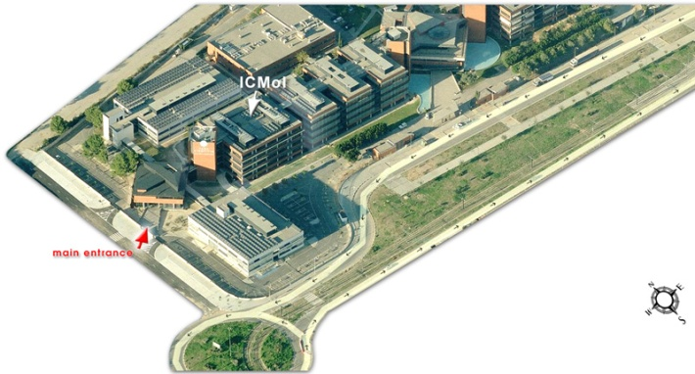
Institute of Molecular Science
Parc
Científic
ETSE
Not the best entrance
À Punt
(TV & radio)
Best entrance
V. Andres Estellés
(tram station)
Third floor
Office 3.1.4
Burjassot
Campus
You are
HERE

Slide 3

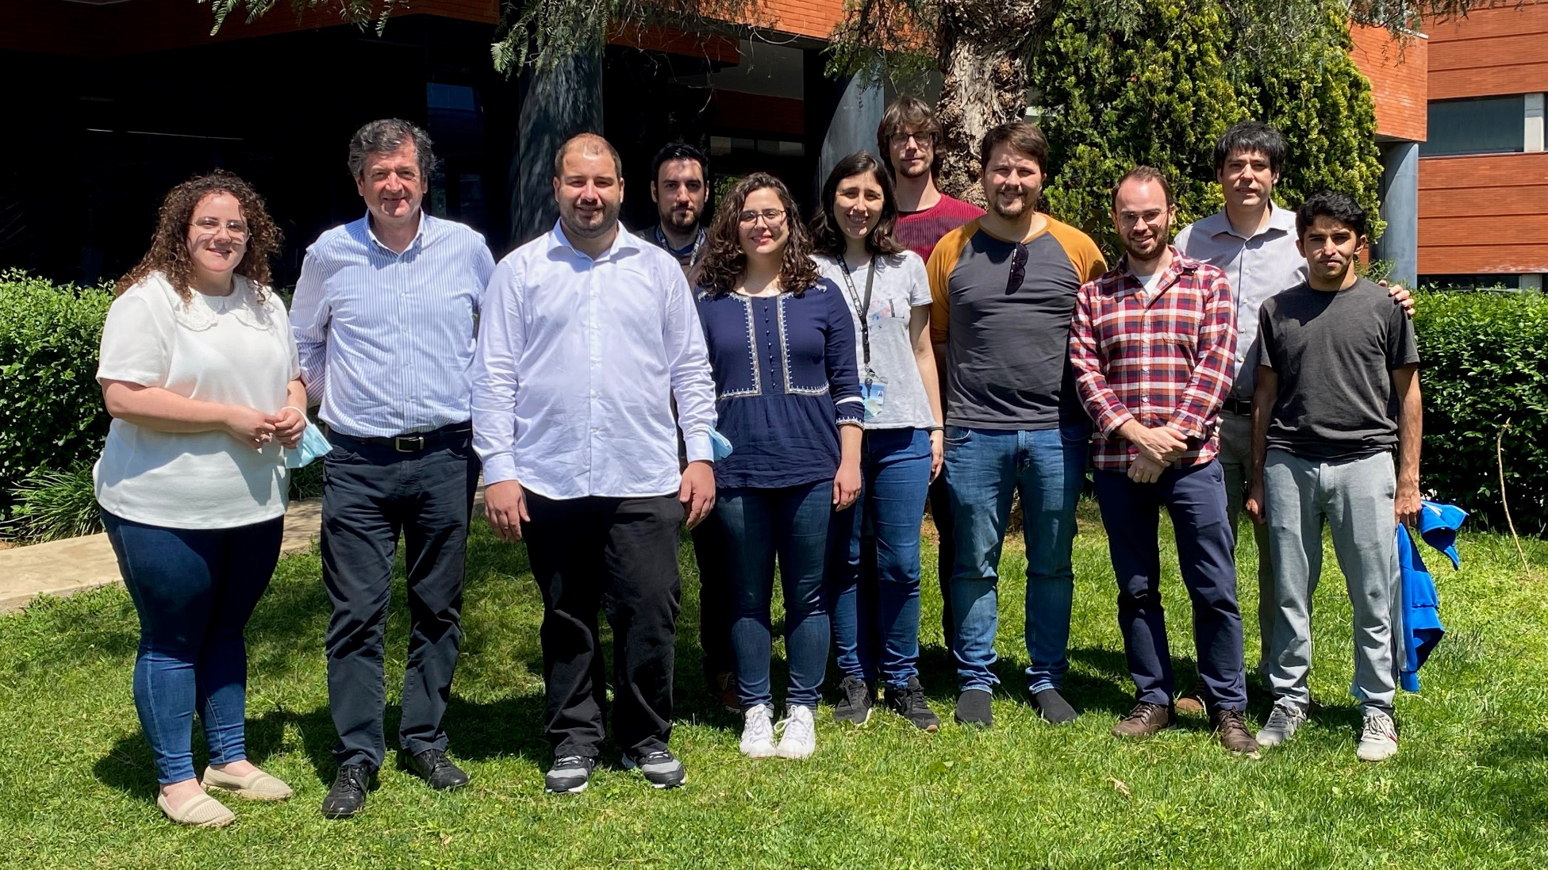
Molecular Material Theoretical Chemistry Group.
http://www.molmattc.com/

Slide 4

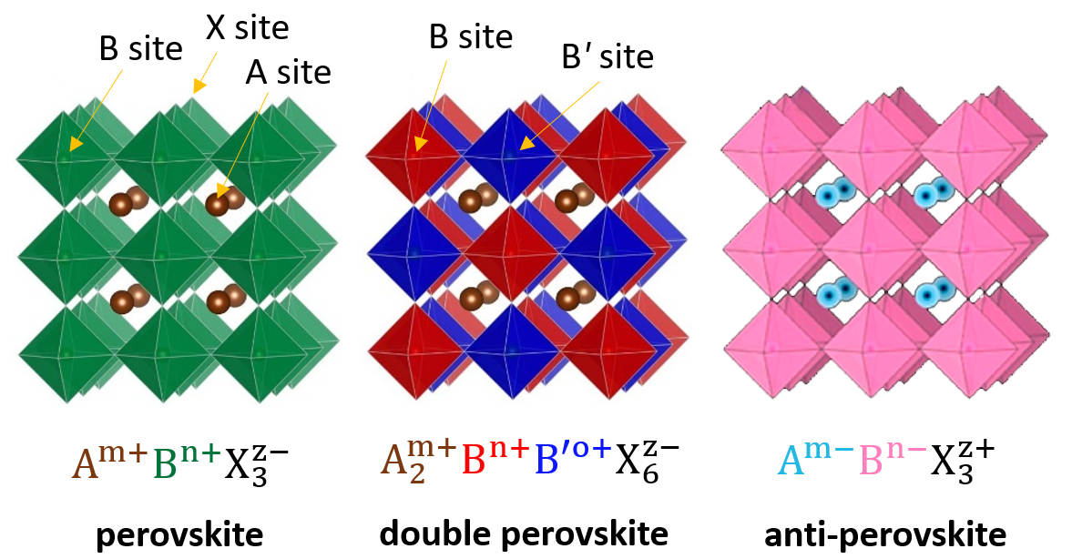






Electroactive metal-organic frameworks and perovskites
• Energy conversion and storage
• Solar cells and electroluminescence
Photoactive frameworks
Perovskite
Conducting MOFs
MIL-101
Redox activity
&
charge transfer
Dr. Joaquín Calbo
joaquin.calbo@uv.es

Slide 5
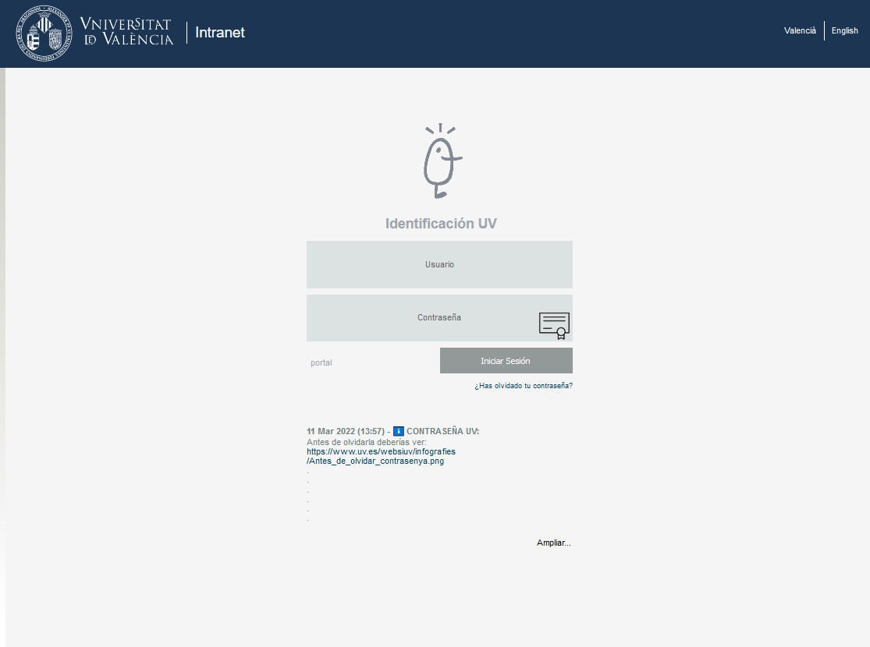



The UV virtual environment
website: https://correo.uv.es
UV user
UV password

Slide 6
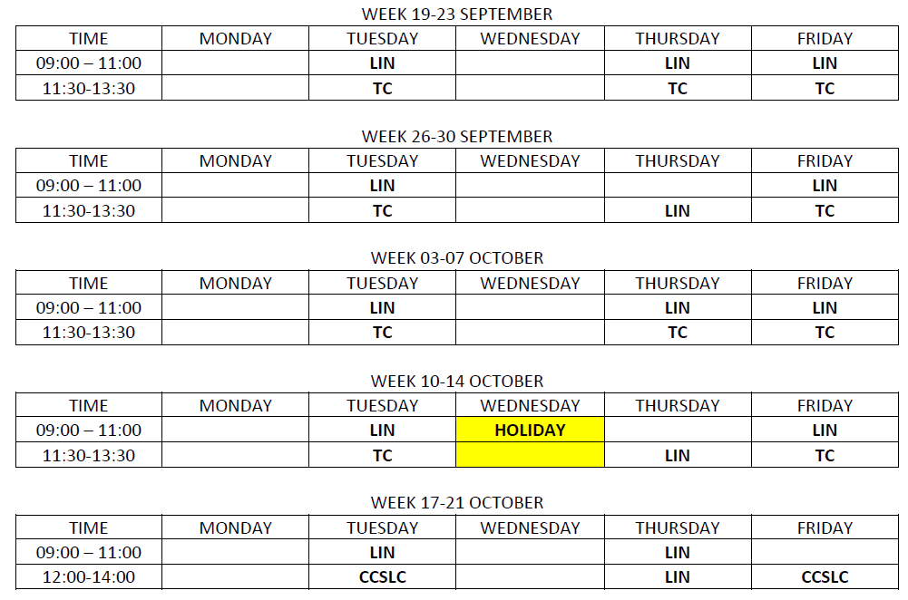
Lectures
Faculty of Chemistry (Building E) - PC-5
TEST

Slide 7
Course content
1) INTRODUCTION
Hardware, OS, cluster access
2) LEARNING THE SHELL
Shell prompt, file system, navigation, manipulation, commands, permissions
3) CONFIGURATION AND ENVIRONMENT
Startup files, environment variables, VI editor, prompt customization
4) COMMON TASKS AND ESSENTIAL TOOLS
Package management, networking, searching, regex, text processing
5) WRITING SHELL SCRIPTS
Writing scripts/projects, conditionals and loops, input data, arrays
Compiling software
Queuing system

Slide 8
Evaluation
1) Exercices along the lectures (continuous assessment)
2) Final exam:
A set of multiple-choice exercises
A programming exercise

Slide 9

Computer components
System fan
Floppy
Heat sink
HDD or SSD
Power supply
Optical drive
Motherboard
Processor (CPU)
RAM modules

Slide 10



Computer components
System fan
Floppy
Heat sink
Graphics card (GPU)
HDD or SSD
Power supply
Screen, keyboard, mouse, etc.
Optical drive
Motherboard
Processor (CPU)
RAM modules

Slide 11
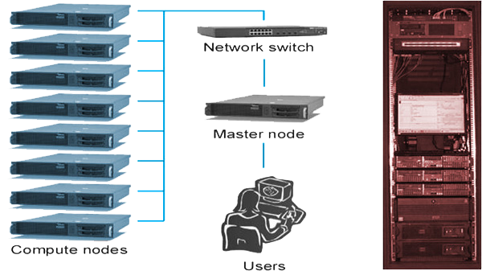
Computer components
System fan
Floppy
Heat sink
Graphics card (CPU)
HDD or SSD
Power supply
Screen, keyboard, mouse, etc.
Optical drive
High Performance computing (Computer clusters)
Motherboard
Processor (CPU)
RAM modules

Slide 12

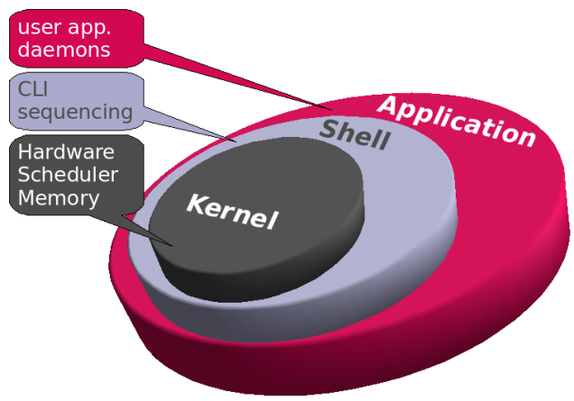
Operating system
LINUX
1) KERNEL: is the hub of the operating system: it allocates time and memory to programs and handles the filestore and communications in response to system calls (CORE).
2) SHELL: acts as an interface between the user and the kernel. When a user logs in, the login program checks the username and password, and then starts another program called the shell. The shell is a command line interpreter (CLI). Examples: zsh, ksh, csh, GNU Bourne-again shell (BASH).

Slide 13


Types of Linux systems
2010: Ubuntu > Fedora > Mint > openSUSE > Debian > …
2020: MX Linux > Manjaro > Mint > Debian > Ubuntu > …

Slide 14





Virtual machines
Windows subsystem for Linux
azure
Cygwin

Slide 15

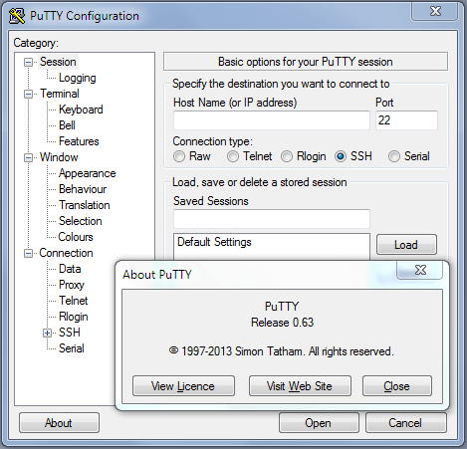
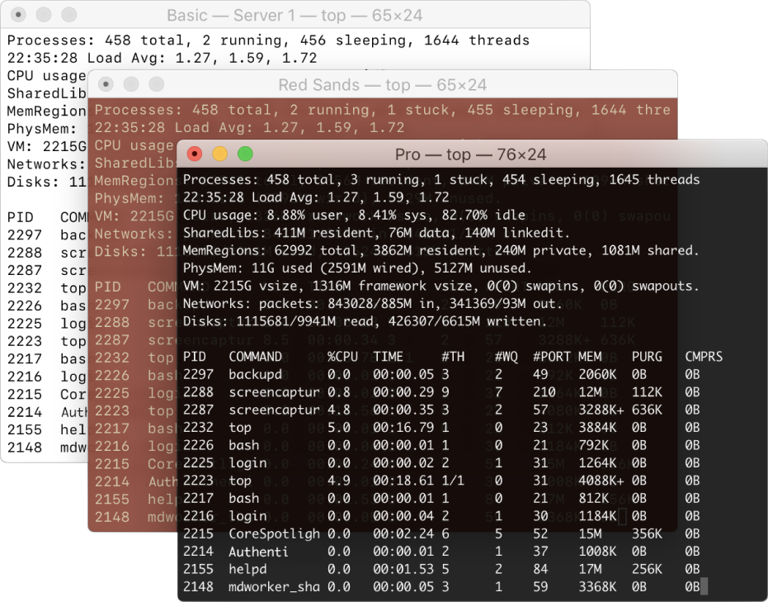
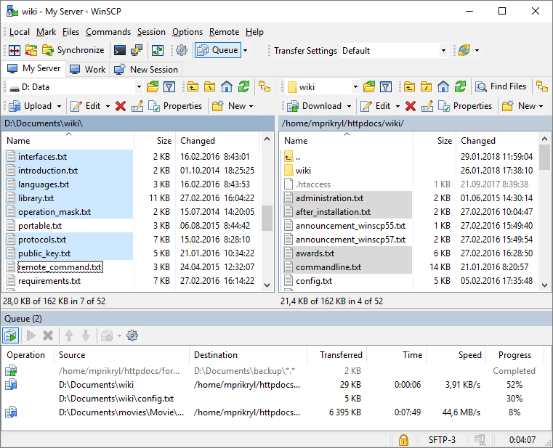
From Mac & LINUX
From Windows
Putty
MobaXterm
Others
Terminal
WinSCP
ssh username@cpuserv.uv.es

Slide 16

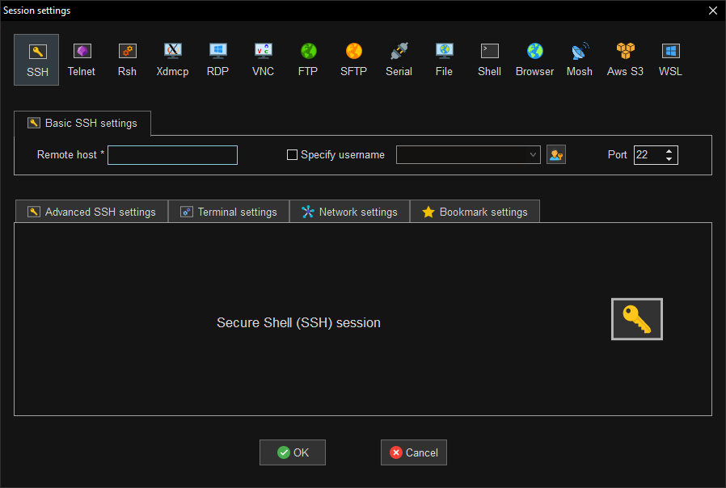

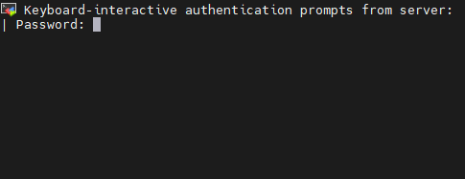
x
cpuserv.uv.es
alumno#
Attention: the cluster has security against several attempts

Slide 17
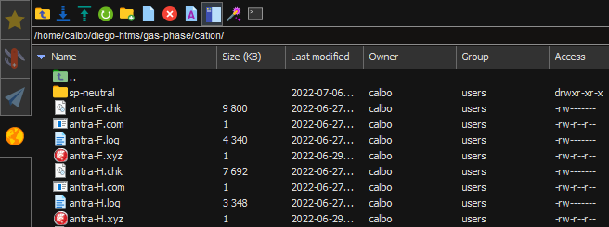
File transfering from local computer to the cluster and viceversa
Download
(from the cluster)
Upload
(to the cluster
@ current folder)
Or simply dragging
Current folder path
Files
&
folders

Slide 18

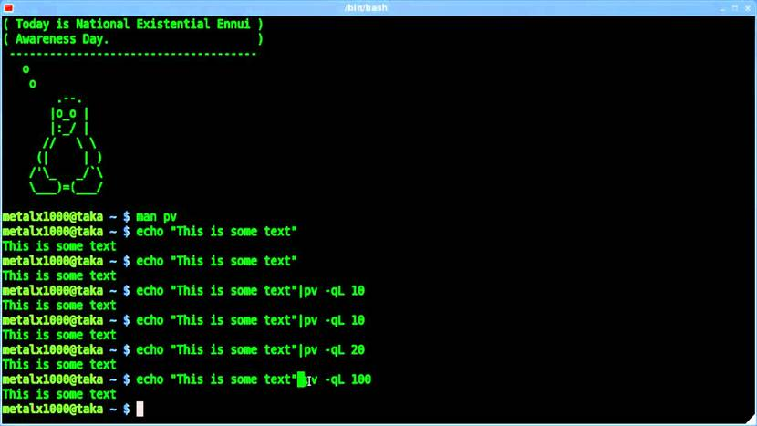
LEARNING THE SHELL

Slide 19
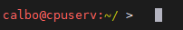
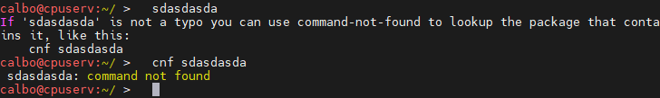


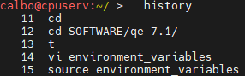


The shell prompt
user @ machine_name : current_path
~ (tilde) = /home/your_user/
The command history & navigation across command line
Prior command used
Next command used
Backward in command line
Forward in command line
File: .bash_history

Slide 20

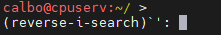
Useful tips before going deep
Command completion
Command finder
Folder information
Navigation assistance
Crtl+C
Ctrl+V
copy Select with cursor
paste Mouse right (middle) click
Does not generally work
for copy-paste. USE INSTEAD:
Reverse command search
by clicking Ctrl+R > start writing command > Ctrl+R ‘till hit

Slide 21
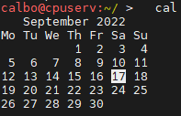
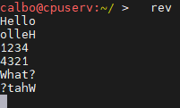
Trying simple/fun commands
CTRL + C requests that the program abort.
CTRL + Z suspends the program and it remains resident as a background task. Suspending a program allows you to resume it later with the command fg. Remaining background tasks are killed when you exit the login shell.
(Sometime is fun to chat)
(Sometime you need to focus)

Slide 22
Retrieving disk space and memory availability
df: Show information about the file system on which each FILE resides, or all file systems by default. Interesting option: -h (human reading)
du: Summarize disk usage of the set of FILEs, recursively for directories. Interesting options: -s (summarize) -h (human reading)
free: display the free amount of memory (-h for humans)
Exiting the shell
exit: Exit the shell.

Slide 23
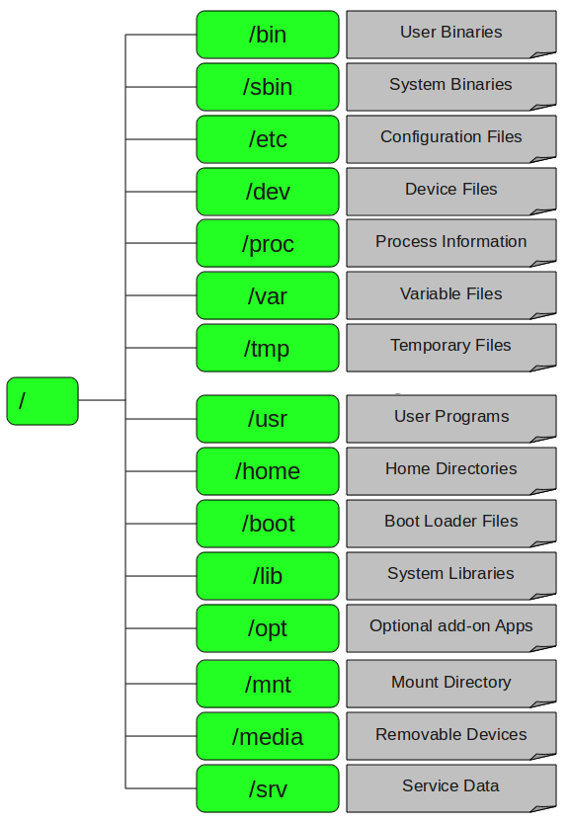
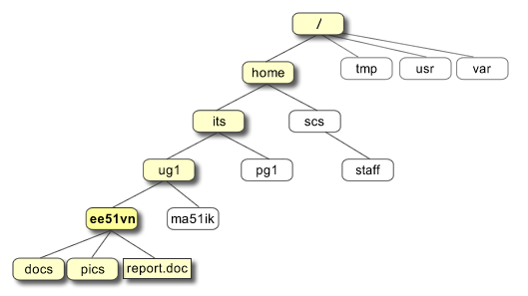
File system - Tree structure
level
from path

Slide 24
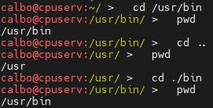
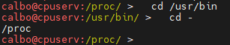

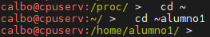
Navigation – File system tree
pwd: print name of current working directory
ls: <file, folder or path>(optional): list directory contents
cd <folder or path>(optional): change directory
Absolute path: /home/calbo/
Relative path: ../../proc/
My home directory
?

Slide 25

Important facts about filenames (and directories)
Filenames that start with a dot “.” are hidden to regular ls.
To list them you need “ls -a”
Filenames and commands in Linux are case sensitive.
“File1” and “file1” are different
Do not use space or punctuation characters in filenames.
Rather you can use dot “.”, dash “-”, or underscore “_”
Linux has no concept of file extension. You may use files any way you like.
Some programs do recognise extension

Slide 26
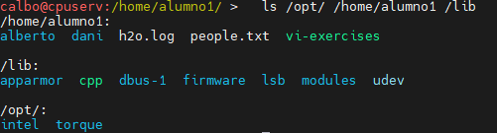
Exploring the system (ls, file, less, cat)
ls: list directory contents
(several paths)
user@machine: path > command -options arguments
user@machine: path > command --help
user@machine: path > help command

Slide 27
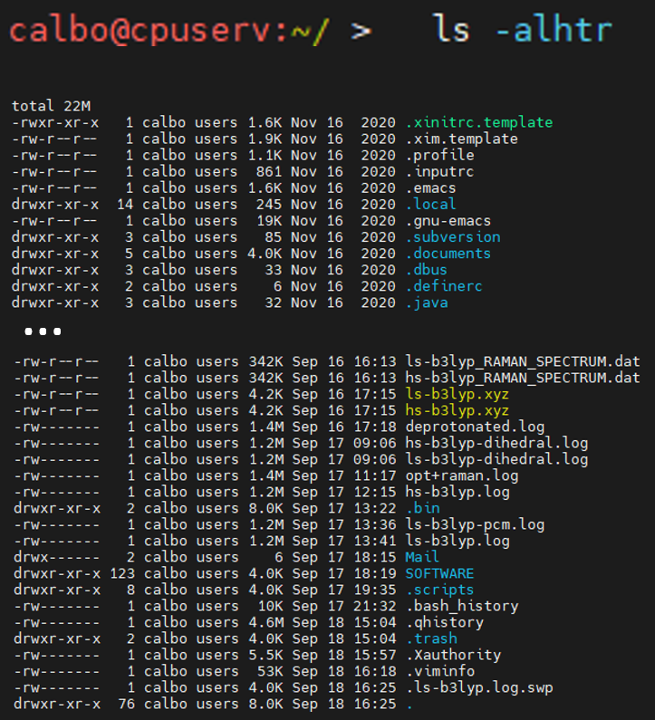
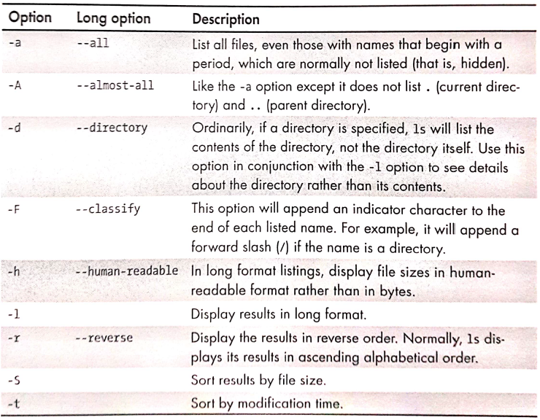

Using the ls command
owner
size
file/directory
permissions
group
last modif
You can clear the terminal with 'clear' command

Slide 28
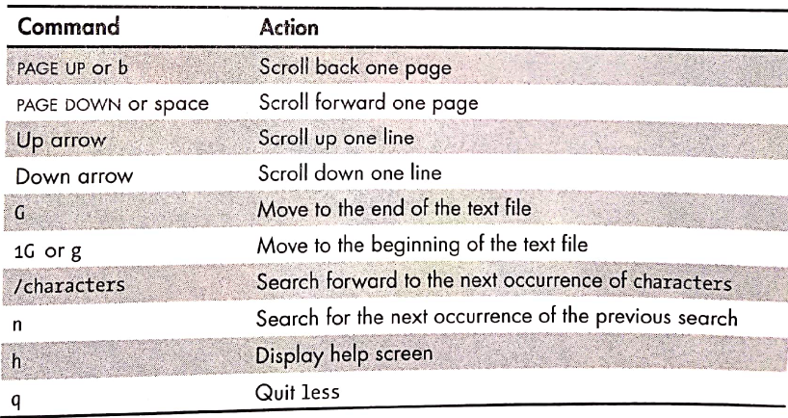
file filename (to determine the type of file)
ASCII text, JPEG, MP3, symbolic link, etc.
Symbolic (soft) link: is a special type of file that points to another file or directory.
less filename (to view text files)
Exercise
Copy file /etc/passwd to your home
and practise with ls, file, less and cat
cat filename (to print file content)

Slide 29
Manipulating files and directories
cp: copy files and directories
mv: move/rename files and directoies
mkdir: create directories
rm: remove files and directories
ln: create hard and symbolic links

Slide 30
Wildcards
Let’s guess what this matches
* Matches any characters
? Matches any single character
[characters] Matches any character that is in the set
[!characters] Matches any character that is NOT in the set
[[:class:]] Matches any character that belongs to the class
Character classes:
[:alnum:]
[:alpha:]
[:digit:]
[:lower:]
[:upper:]
Pattern | Match
*
g*
b*.txt
Data???
[abc]*
BACKUP.[0-9]
[[:upper:]]*
[![:digit:]]*
*[[:lower:]123]

Slide 31
mkdir & cp commands
mkdir directory_name
mkdir dir1 dir2 dir3 …
cp item1 item2
(copies file or directory item1 to file or directory item2)
cp item1 item2 item3 … dir1
(copies multiple files or directories into a directory (must exist)
Attributes to cp: cp -r (recursively copies a directory and its contents)
cp -i (interactive: before overwriting files, prompt the user for confirmation)
cp -v (verbose: display informative messages)

Slide 32
mv & rm & rmdir commands
mv item1 item2 (move or rename file or directory item1 to item2)
mv -i (interactive: before overwriting files, prompt the user for confirmation)
Example: mv -i file1 file2 file3 dir1
rm items… (does not usually work for directories)
rm -i (interactive)
rm -r (recursively deletes directories)
rm -f (force removing)
rm -v (verbose)
rmdir directories... (deletes directories if they are empty)
VERY CAREFUL WITH rm:
rm -rf /*

Slide 33
Hard and symbolic (soft) links
Hard links and symbolic links are two different methods to refer to a file (directory) in the hard drive.
Hard link: A hard link is essentially a synced carbon copy of a file. A hard link cannot reference a file outside its own file system. A link cannot reference a file that is not on the same disk partition. A hard link may not reference a directory.
ln file link
Symbolic link: Symbolic links are essentially shortcuts that reference to a file/directory. They overcome the limitations of hard links.
ln -s file link
If you enter in the link and modify the file, the original file is modified.
If you delete the link, the original file is not deleted.
If you delete the original file, the link persist but will to point to nothing (broken)

Slide 34
Exercise - Building a playground
1) Make sure you are at your home directory
2) Create a new directory called 'playground'
3) Create two directories 'dir1' and 'dir2' inside 'playground'
4) Copy the file 'passwd' that you will find in '/etc' directory into the 'playground' folder
5) Check 'passwd' is copied in your 'playground' directory
6) Try to copy again file 'passwd' from '/etc' into 'playground' with '-i' (interactive) attribute
7) Change 'passwd' file name to 'fun'
8) Let's move 'fun' file into 'dir1' (check)
9) Now move 'fun' file from 'dir1' to 'dir2' (check)
10) Move 'fun' file back to 'playground' directory
11) Move again 'fun' file into 'dir1'
12) Move 'dir1' into 'dir2'
13) Get back to the original situation (4)

Slide 35
Exercise - Building a playground
14) Let's create a hard link called 'fun-hard' in 'dir1' that points to 'fun' file
15) Check the size and content of 'fun-hard' link compared to the original file 'fun'
16) Create a symbolic link to 'fun' called 'fun-soft' in 'dir2'
17) Check the information that contains 'fun-soft' and its size
18) Create a symbolic link to 'dir1' in 'playground' called 'dir-sym'
19) Change directory to 'dir-sym' and check where you are
20) Remove 'dir1' with 'rmdir' command
21) Remove 'fun' file from 'playground' directory
22) Check the information that contains 'fun-soft' link from 'dir2'
23) Remove 'dir2' by using the '-r' attribute of 'rm' command
24) Change directory to your home and delete the 'playground' folder
Careful with
Relative/absolute
paths

Slide 36
Working with commands
type: indicate how a command name is interpreted (determines if command is alias, function, built-in command, cached executable (hashed), binary in $PATH, etc.)
which: display which executable program will be exectuted (finds executable in your $PATH)
help: get help for shell builtins (or command --help)
man: display a command's manual page
whatis: display one-line manual page descriptions
alias: create an alias (shortcut) for a command (unalias to delete it)
$PATH

Slide 37
Creating your own commands with alias
Before that, a small trick: You can put several commands on a line by using ; (semicolon)
command1; command2; command3; ...
Exercise
A) First learn how 'alias' command works. Now, let's create a command that (1) changes to directory '/usr', then (2) lists all the content of that folder, and finally (3) goes back to the original directory. If I want to call this command 'test', would it be OK? If not, try with 'foo'. Check it works. Afterwards, delete that alias.
B) Create a shortcut (alias) to list the content of a folder in a chronological order (the latest modified files must be at the bottom), with all the information, and with a human-readable language for item size.
A tiny problem in defining aliases on the command line: they VANISH when your shell session ends.
.bashrc

Slide 38
I/O Redirection
???
input
cat: concatenate files
sort: sort lines of text
wc: (word count) print newline, word, and byte counts for each file
head: output the first part of a file
tail: output the last part of a file
tee: read from standard input and write to standard output and to file
grep: print lines matching a pattern (global regular expression print)

Slide 39
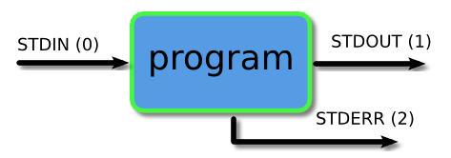
Standard input, output and error
Programs (sometimes) need inputs, and (sometimes) produce outputs, and (hopefully not many times) gives error (or status) messages.
ls /usr/bin
input -> standard input (or stdin) -> keyboard
output -> standard output (or stdout) -> screen
error -> standard error (or stderr) -> screen
We can redirect
Let's try this:
ls -l /usr/bin > ls-output.txt
ls -l /nonexistent > ls-output.txt
> redirects stdout but not stderr
With > the destination file is rewritten
We use >> to append

Slide 40
Redirecting standard error
ls -l /nonexistent 2> ls-error.txt
Redirecting stdout and stderr to one file (2>&1)
du -h /home/aliaga > du-info.txt 2>&1
Disposing of unwanted output/error (/dev/null)
(if someone sends your opinion there, reconsider friendship)
du -h /home/aliaga 2> /dev/null
Redirecting standard input
cat filename
cat (waiting 'till stdin)
cat > output.txt
Ctrl+D = EOF
(waiting 'till stdin)

Slide 41

Pipelines
command1 | command2 | command3 | ...
the output of command1 goes as input of command2, and the output of command2 goes as input of command3
Exercise
1) Learn how to use 'sort' command to sort lines
2) In one single command line perform the following tasks: - Use cat to print the content of /etc/passwd file
- sort this content by reverse alphanumeric order
- Use less to print the result interactively
3) Try to do the same as (2) but now sorting by the field 5 separated by ':'

Slide 42
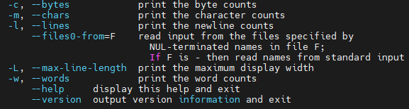
wc: display the number of lines, words, and bytes contained in files
head: print the first part of a file
tail: print the last part of a file
tee: read from stdin and output to stdout and files
grep: global regular expression print (print lines matching a pattern)

Slide 43
Exercise combining previous commands
In one single command line, perform the following:
i) take the first ten lines of file /etc/passwd
ii) from those lines, take the last four
iii) from these four lines choose those that contain the word 'client'
iv) print the total number of characters in the text generated
v) display the output in screen and also save it in file 'output.dat'
wc: words, lines, bytes count
head: print first lines
tail: print last lines
tee: read from stdin and output to stdout and files
grep: print lines matching a pattern

Slide 44
Seeing the world as the shell sees it
(interesting and complex features of the shell)
echo: display a line of text
echo This is a test
echo *
cd /usr/bin
ls
echo h*
echo *a
echo [[:upper:]]*
echo /home/*
echo /home/a*/*b
Pathname expansion
Tilde expansion
echo ~
echo ~alumno3
(a hard one)

Slide 45
Arithmetic expansion
Available operators:
+
-
*
/
% (modulo=remainder)
** (exponentiation)
Remember:
Expansion supports only integer arithmetics
Results are integers
bc -l for advanced maths
echo $(( 2+2 ))
echo $(( expression ))
echo $(( (5**2)*2 ))
Exercise: using 'echo' and arithmetic expansion, print a sentence displaying the result of dividing 5 by 2, and also gives the remainder.
Brace expansion
You can create mutiple text strings from a pattern containing braces. Useful for printing a list of items
echo Sentence-{A,B,C}
echo Number_{1..6}
echo {01..15}
echo M{1..3}{A..C}
Exercise: Go to your home. Create a folder called Photos. Create a series of folders inside 'Photos' named in the format 'year-month' from year 2017 to 2022 (for each month as a number).

Slide 46
Parameter expansion
echo $USER
variable
printenv
list all available environment variables
echo $USSER
Command substitution
echo $( ls )
echo $( echo "7.31/4" | bc -l )
file $( ls -d /usr/bin/* | grep zip )
$( commands ) is equivalent to `commands`

Slide 47
Quoting
echo This is a test
echo The total amount is $300
touch two words.txt
touch creates a file in case it does not exist
Double quotes
echo "This is a test"
echo "The total amount is $300"
touch "two words.txt"
echo $(cal)
echo "$(cal)"
Single quotes (to supress all expansions)
Pathname expansion
Tilde expansion
Arithmetic expansion
Brace expansion
Parameter expansion
Command substitution
echo /usr/bin/B* ~ $(( 2+2 )) {a..d} $USER $(echo foo)
echo "/usr/bin/B* ~ $(( 2+2 )) {a..d} $USER $(echo foo)"
echo '/usr/bin/B* ~ $(( 2+2 )) {a..d} $USER $(echo foo)'

Slide 48
Escaping characters (\ or backslash)
echo "The balance for user $USER is: $5.00"
echo "The balance for user $USER is: \$5.00"
Special characters with \
\a alert
\b backspace
\n newline
\r carriage return
\t tab
Using echo, they work with attribute -e
sleep 10; echo -e "Wake up! \a"
echo -e "line1 \n line2 \n line3"
echo -e line1 "\n" line2 "\n" line3
echo -e Table"\t"content

Slide 49
Permissions
id: display user identity
chmod: change file permissions
umask: Set the default file permissions
su: run a shell as another user
sudo: execute a command as another user
chown: change the owner of a file
passwd: change a user's password

Slide 50

Owners, group members, and everybody else
file /etc/shadow
less /etc/shadow
id
user id
group id
/etc/passwd
/etc/group
/etc/shadow
user accounts
groups
passwords

Slide 51
Owners, group members, and everybody else
Reading, writing, and executing
ls -l /etc/shadow
group
owner
file attributes (9)
r (read) w (write) x (execute)
file type
owner group world
– – – – – – – – –
r w x r w x r w x
–
– regular file d directory l symbolic link

Slide 52
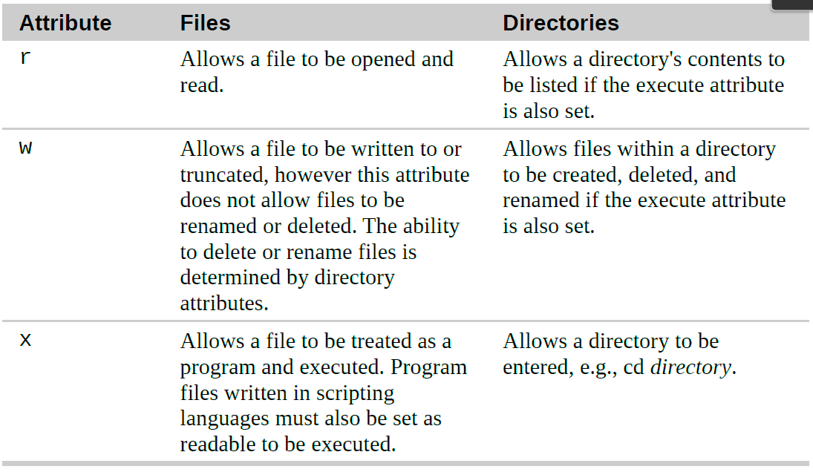
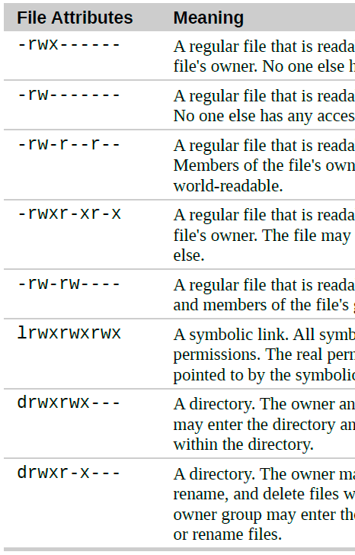
Attributes and their meaning
Let's guess permissions
❶
❷
❸
❹
❺
❻
❼
❽

Slide 53
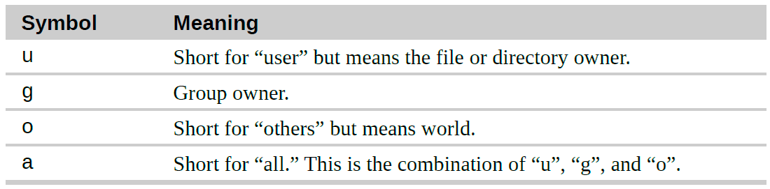
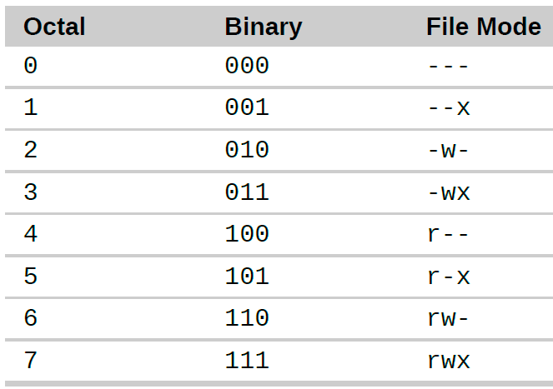
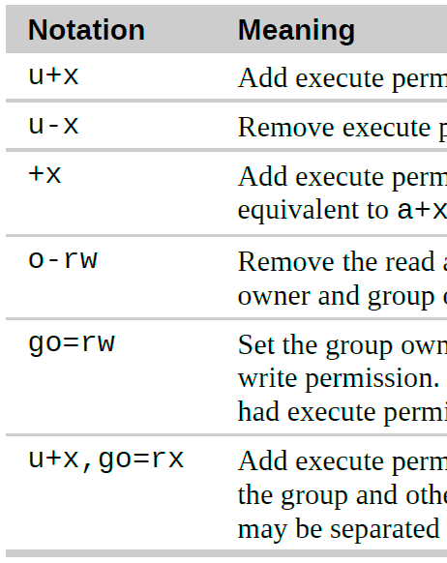
Changing the permissions
chmod: changes the mode (permissions) of a file or directory
Symbolic representation
Octal number representation
Humans: ten fingers → base 10
Computers: one finger → binary → 0, 1, 10, 11...
Octal: 0, 1, 2, 3, 4, 5, 6, 7...
group
owner
others
Permissions are specified with the “r”, “w”, and “x” characters.
chmod u+rx file
(for owner, add rx permission)
chmod -rwx file
(for all, remove rwx)
chmod go=rw file
(for group and others, only rw)
❶
chmod 777 file
chmod 755 file
chmod 700 file
chmod 644 file
chmod 640 file
❷
❸
❹
❺

Slide 54
umask: to change default permissions given to a file when it is created
(files) (directories)
umask 0000: all permissions allowed → -rw-rw-rw- drwxrwxrwx
umask 0022: we remove some writing permissions → -rw-r--r-- drwxr-xr-x
umask 0026: we remove some rw permissions → -rw-r----- drwxr-x--x
Exercise
1) Create a file called 'script' by means of touch command.
2) Check its permissions
3) Insert "echo Hello world" inside the script file
4) Try to execute the script by typing ./script
5) Give permissions to script to allow execution for everybody, read and write for the owner, and only read for the group and others.
6) Execute again the script

Slide 55
Changing identities
su: run a shell with substitute user
su alumno3
sudo: execute a command as another user
sudo -u alumno3 ls /home/alumno3
chown: change file owner and group
chown bob:users file...
passwd: change your password

Slide 56
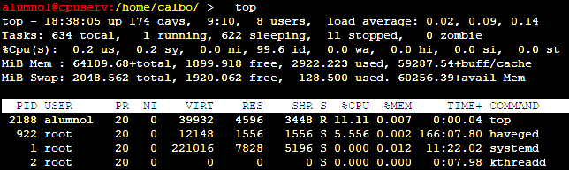
A bit of processes
top: display tasks
jobs: list of active jobs
fg: place a job in the foreground
bg: place a job in the background (also with & at the end of command line)
kill: cancel a process
killall: kill processes by name

Slide 57
Exercise
1) Let's first check the total amount of jobs that are running on:
top -u alumno# (Q for quiting and SPACE for updating the information)
2) Now execute a sleep command in several ways:
sleep 1000 (then Ctrl+Z to stop it)
sleep 1000 & (to place the job in the background)
3) Check with top that the two processes are still there.
4) Check with jobs that one process is running and the other is stopped:
jobs (the option -l gives the ID number of the process)
5) Kill the two processes:
kill #ID kill -9 #ID (to kill a stopped job) killall -u alumno#

Slide 58

CONFIGURATION
AND
ENVIRONMENT

Slide 59
The environment
environment variables (local) shell variables aliases shell functions
We can examine the environment variables (and their value) available by:
printenv
The set command will display the shell and environment variables, and shell functions
set
to make a local variable extensible to other (sub)processes, use export command
Sometimes is easier to simply use echo
echo $HOME
environment
number=32; echo $number
local
to unset a variable use
unset command
One thing is not printed by set or printenv: aliases
alias

Slide 60
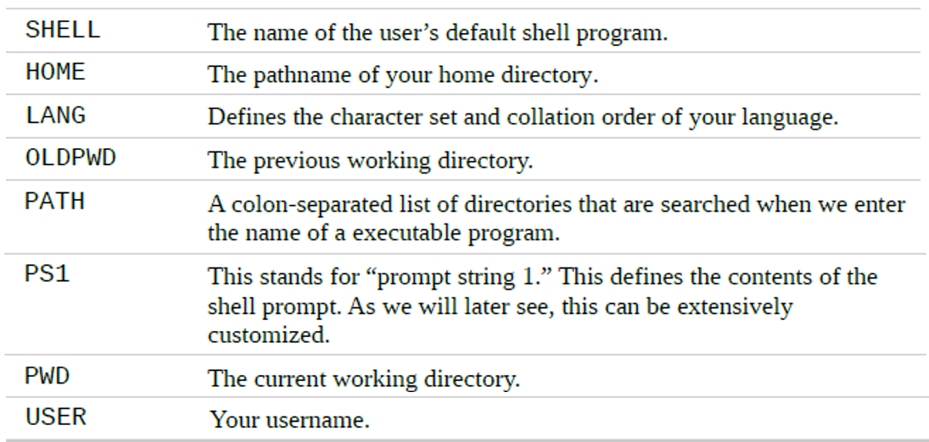
Interesting environment variables

Slide 61
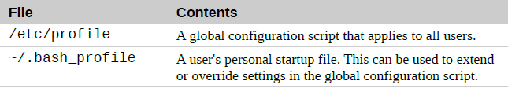
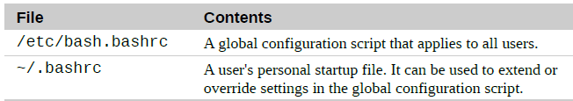
How is the environment established?
Configuration scripts called startup files:
> startup files for default environment shared by all users
> startup files for user specific environment
Startup Files for Login Shell Sessions (you are prompted for user and password)
Startup Files for Non-Login Shell Sessions (you launch a terminal session in the Graphical User Interface - GUI)

Slide 62
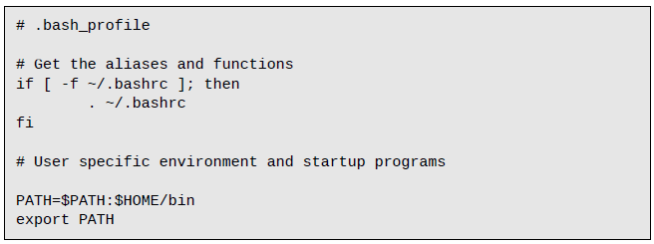

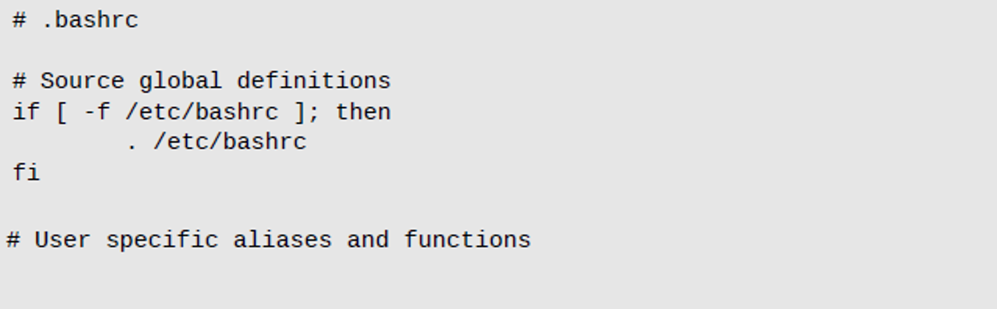
comment
conditional
loads the user bashrc configuration file
. is synonymous with source
setting PATH
environment
variable
/etc/bash.bashrc ]; then
. /etc/bash.bashrc
loads the global bashrc configuration file
Activating our changes
source $HOME/.bashrc
source $HOME/.bash_profile

Slide 63
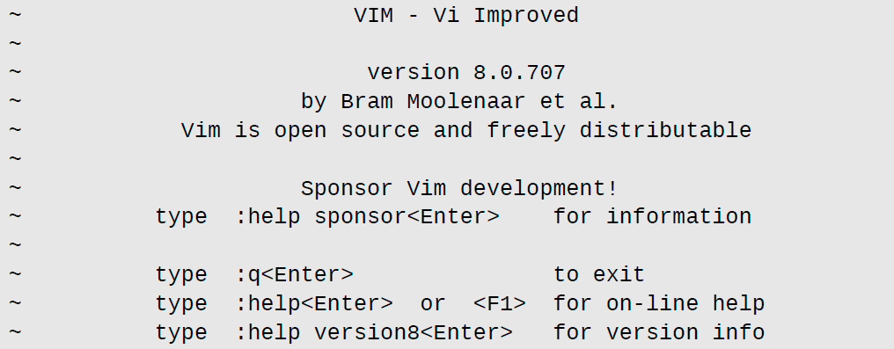



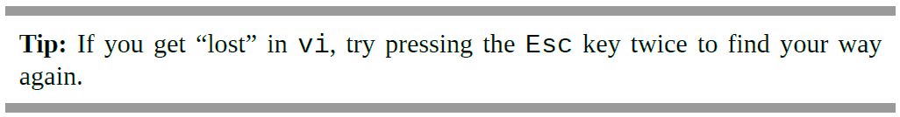
The VIsual editor (VI)
Starting and stopping vi
Quit
Force Quit

Slide 64



Editing mode
When vi starts, it begins in command mode. In this mode, almost every key is a command, so if we were to start typing, vi would basically go crazy and make a big mess.
Insert mode: type i
To exit insert mode and return to command mode, press the Esc key.
Saving Our Work
save into another file
save and quit
<newfile>
: wq

Slide 65
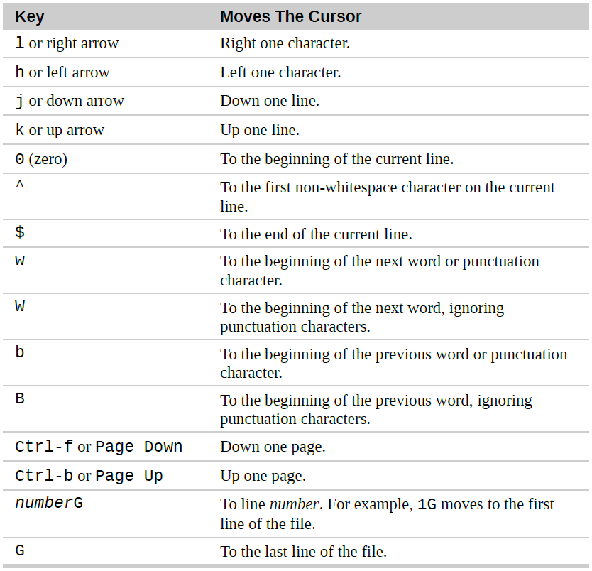
Cursor Movement Keys
gg To the beginning of file.
Ctrl-d Move down (half page)
Ctrl-u Move up (half page)
:10 Move to line 10
:set nu Sets line numbers
:set nonu Unsets line numbers
Markers
1) Positionate cursor to desired line
2) Press m <character>
3) Use '<character> to refer to the marked line

Slide 66
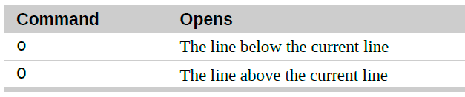
Inserting Text
Inserts
i
text at cursor position
I
text at the beginning of line
Appending Text
Appends
a
text after cursor position
A
text at the end of line
Opening a Line
Opens
a newline below the current line
a newline above the current line
Replacing Text
Replaces
r
a character for another
R
a list of characters by others

Slide 67
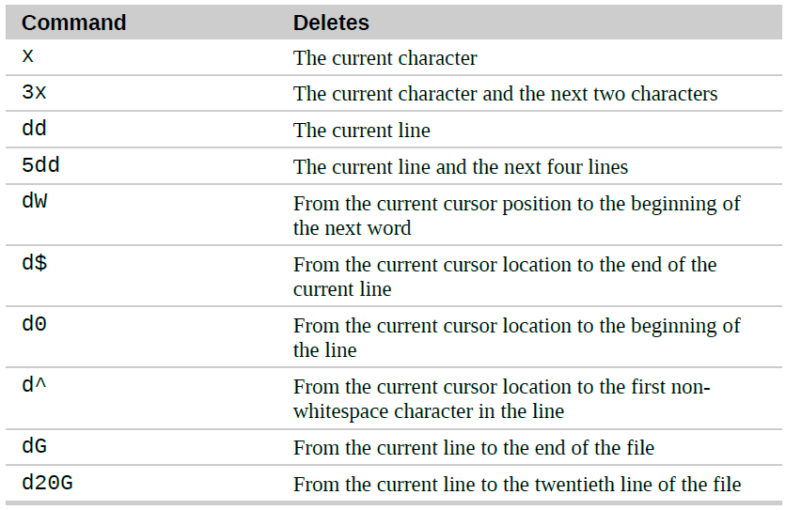
Deleting Text
dgg From the current line to the beginning of file
:'a,. d From marked line 'a' to the current line

Slide 68
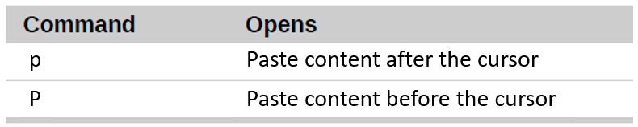
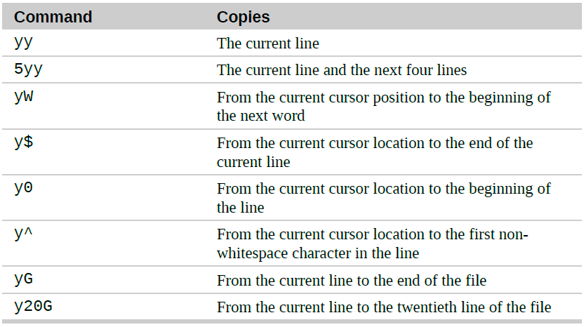
Undo / Redo
Cutting, Copying, and Pasting Text
u to undo changes
Ctrl + r to redo changes
The x and d commands not only delete text, they also “cut” text. When we use them, the deletion is copied into a paste buffer that we can later recall with paste:
Pastes
content after the cursor
content before the cursor
Joining lines
Copies
J join next line to current one
(like removing end-of-line
character)
Search and place
/ search a word or phrase (forwards)
? search a word or phrase (backwards)
n next matching pattern
N previous marching pattern
ygg From the current line to the beginning of file
:'a,'b y From marked line 'a' to marked line 'b'

Slide 69



Global search-and-replace
% to specify the range of lines for the operation, in this case, from first to last line.
s to perform the substitution
/Line/line/ to specify find pattern (Line) and replacement text (line)
g performs the operation globally, i.e. not only the first match in each line.
c make it interactive
Editing multiple files
horizontal separation
vertical separation
vi -o file1 file2
vi -O file1 file2
move to next file
Ctrl + ww
move cursor to next file
:wqa
:qa!
Ctrl + w + arrows
move cursor to next file
move to previous file
:windo %s/replace this/by that/g
An .swp file is a swap file created by the Vi text editor
It stores the recovery version of a file being edited in the program.
Visual Block Mode
Ctrl + v

Slide 70
Most used commands
ESC command MODE
i insert MODE
Ctrl + v visual block MODE (yank, delete, replace)
:q quit (:q! force quit)
:w (file) save (with name file)
:wq save and quit
dd delete line
d3 delete 3+1 lines
:1,3 d delete from line 1 to line 3
:2,. d delete from line 2 to current line
:4,$ d delete from line 1 to the last one
x delete character
yy yank (copy) line
p paste
o add new line after
O add new line before
i insert before
a insert after (add)
u undo
r replace character
Ctrl+R redo
arrows move around (sometimes do not work)
h/j/k/l move left/down/up/right
w move between word beginnings
e move between word endings
G move end of file
gg move beginning of file
^ move beginning of line
$ move end of line
:number move to number line
Ctrl+d move down
Ctrl+f move forward (faster)
Ctrl+u move up
Ctrl+b move backward (faster)
Ctrl+ww move between windows (vi -o / -O)
m+a set a mark in current line as "a"
:'a,. d delete from line with mark "a" to current line
:%s/replace this/by that/g
/ search a pattern (can use ^ and . and * and $)
(n → go to next match)
(N → go to previous match)
:windo %s/replace this/by that/g
:set nu(mber) :set nonu(mber)

Slide 71
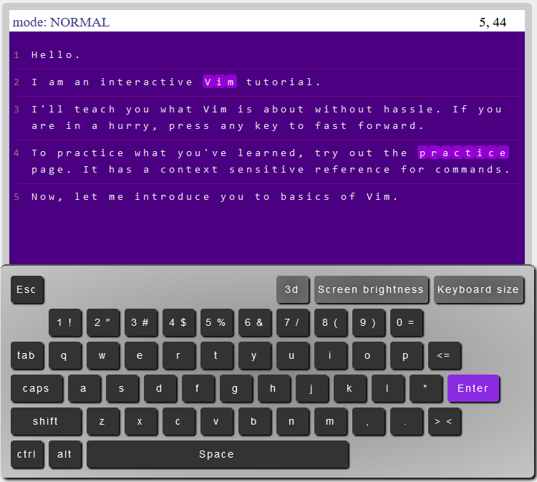
https://www.openvim.com/

Slide 72
Let's practise with VI
1) Check if there's a file called 'h2o.log' in the home directory of alumno1
2) Check the permissions of it and if you can copy the file to your home
3) Ask the professor the correct permissions you need for copying the file, and copy it
4) Practise everything you have learnt from VI editor:
- Cursor Movement
- Insertion Mode (insert, append, add line, replace...)
- Copy, Cut, Paste, Delete...
- Undo/Redo
- Search (/) and search-and-replace (:%s///g)
- Copy /etc/passwd file to your home and play with several files at once

Slide 73


Customizing user startup files
.bash_profile is read and executed when Bash is invoked as an interactive login Shell
.bashrc is executed for an interactive non-login shell.
Not all OS load the .bashrc upon login
To load the changes made:
source $HOME/.bash_profile
if [ -f /etc/bash.bashrc ]; then
. /etc/bash.bashrc
fi
(1) Create an alias that counts the number of files and directories in the current directory.
(2) Create an alias that takes a break (sleep) of 5 seconds and then says 'Wake up!'
(3) Create an alias that prints the nodes that are free. 'Nodos' prints the list of available nodes.
alias ll='ls -l --color=auto'
alias hello='echo Hi there $USER, how are you doing?'
(create your own aliases)
\command Temporarily Stop Using Aliases (e.g. \ls)

Slide 74

Customizing the Prompt
echo $PS1 # <--- Environment variable
To add colors ➔ \e[x;ym where x;y is the color pair
Color | Code
Black | 0;30
Red | 0;31
Green | 0;32
Brown | 0;33
Blue | 0;34
Purple | 0;35
Cyan | 0;36
Light gray | 0;37
Background | Code
Black | 0;40
Red | 0;41
Green | 0;42
Brown | 0;43
Blue | 0;44
Purple | 0;45
Cyan | 0;46
Light gray | 0;47
1 for bold
\e[m back to default color settings
It's your turn!!!
\ ] Signals the end of a non-printing character sequence.

Slide 75


COMMON TASKS
AND
ESSENTIAL TOOLS

Slide 76

Package Management
Installing a Package from a Repository
apt-get install package_name Debian
yum install package_name Red Hat
zypper install package_name OpenSUSE
zypper search <name>
zypper install <name>
zypper remove <name>
zypper install --help
YaST Software Management (interactively)
zypper install /path/to/manually/downloaded.rpm
Tarball files (.tar / .tar.gz / tar.bz2)
INSTALL, README

Slide 77


Storage Media
mount – Mount a file system
umount – Unmount a file system
fsck – Check and repair a file system
fdisk – Manipulate disk partition table
mkfs – Create a file system
/etc/fstab lists the devices (typically hard disk partitions) that are to be mounted at boot time
Device
Mount point
FS type
Options
Frequency
to be backed up
Order
for checking
device on mount_point type file_system_type (options)

Slide 78
Networking
● ping – Send an ICMP ECHO_REQUEST to network hosts
● traceroute – Print the route packets trace to a network host
● ip – Show / manipulate routing, devices, policy routing and tunnels
● ftp – Internet file transfer program
● ssh – OpenSSH SSH client (remote login program)

Slide 79
ping command sends a special network packet called an ICMP ECHO_REQUEST to a specified host. Most network devices receiving this packet will reply to it, allowing the network connection to be verified.
www.google.com cpuserv.uv.es
A properly performing network will exhibit 0 percent packet loss.
traceroute lists all the “hops” network traffic takes to get from the local system to a specified host.
For routers that provided identifying information, we see their hostnames, IP addresses, and performance data
ip is a multi-purpose network configuration tool that makes use of the full range networking of features available in modern Linux kernels. It replaces the earlier and now deprecated ifconfig program. We can examine a system's network interfaces and routing table
ip address
> Three network interfaces: loopback interface (lp) and two ethernet interfaces (eth#)
> UP indicates that the network interface is enable
> Valid IP address in the inet field

Slide 80


Transporting Files Over a Network
ftp (file transfer protocol)
you often see URIs starting
with the protocol ftp://
FTP (in its original form) is not secure because it sends account names and passwords in cleartext

Slide 81

Secure Communication with Remote Hosts
ssh - (secure shell) solves the two problems of secure communication with a remote host.
1. It authenticates that the remote host is who it says it is (thus preventing so-called man-in-the-middle attacks).
2. It encrypts all of the communications between the local and remote hosts.
we login as root
we login as bob
All known host addresses are saved in ~/.ssh/known_hosts file
id_rsa.pub
Public keys allowed to connect to our profile are saved in ~/.ssh/authorized_keys file.
ssh-keygen command generates public (id_rsa.pub) and private (id_rsa) keys.
Exercise: 'Nodos' lists the available computer nodes in cpuserv computer cluster: 1) Check that when you enter (ssh) to a node, known_hosts file is updated.
2) Generate in cpuserv a public key (ssh-keygen) to be recognised by other computers.
3) Set that key in the authorized_keys file to allow entering to any of the cpu### node without re-entering password

Slide 82

We can perform a task on the remote system and redirect the output to a file on the local system:
Exercise: retrieve the line that contains the CPU model name of cpu409 from file /proc/cpuinfo
Tunneling with SSH
When you establish a connection with a remote host via SSH an encrypted tunnel is created between the local and remote systems. SSH protocol allows most types of network traffic to be sent through the encrypted tunnel.
Perhaps the most common use of this feature is to allow X Window system traffic to be transmitted.
On a system running X server (that is, a machine displaying a GUI), it is possible to launch and run an X client program (a graphical application) on a remote system and have its display appear on the local system.
(On some systems, you may need to use the “-Y” option rather than the “-X” option to do this)
alias ssh=ssh -X

Slide 83

scp and sftp (secure versions of cp and ftp)
scp
file1.dat bob@remote-sys:
sftp
Exercise:
1) Use the scp command to copy /lib/lsb/init-functions to your home of cpuserv.
2) Use the sftp command to get /lib/apparmor/apparmor.systemd to your home of cpuserv.

Slide 84

Searching for Files
locate command is installed in /home/calbo.
Alias it as in from /home/calbo/.local/bin/locate
locate – Find files by name
updatedb – Update the database
locate will search its database of pathnames, and outputs any that contain the string bin/zip
Exercise
1) Locate all the files containing "sample.txt" and display the total amount of matches.
2) Display the first 10 matches of files that have the '.html' extension
3) Search for the files with the exact name "prueba.com"
4) Repeat 1) but now using the strategy applied in 3), and in one command line get the number of files containing "sample.txt" that are not exactly named "sample.txt"

Slide 85

find – Find Files the Hard Way
(or /home/alumno1)
Tests
(The find man page has all the details)
Exercise:
Search in /home/calbo only files that end with the extension '.com' and have a size greater than 100 kilobytes. Check with 'ls' command the exact size of one of those files to confirm.

Slide 86




What if we want to add new requirements to the search?
Operators
Predefined Actions
EXTREME CAUTION!
User-Defined Actions
special characters must be quoted or escaped.

Slide 87
A Return to the Playground
1) First, let’s create in our home a playground directory which contains a list of subdirectories 'dir-###' from 001 to 100
2) With 'touch' command, create a list of files 'file-@' where @ goes from A to Z, in each directory dir-###.
3) Now, find all the files named 'file-A' in playground directory, and then print the total number of matching files.
4) Create a file called 'timestamp' in playground and check its status by means of 'stat' command.
5) Touch 'timestamp' again and check its status has been updated.
6) Now, touch all files named 'file-B' of the playground by combining 'find' command, some tests like '-type' and '-name', and a user-defined action such as -exec touch '{}' ';'
7) Find among all the files in playground, those that are newer (test -newer) compared to 'timestamp'.
8) Let's find all files and directories that have no zero permissions for 'group' and 'others'.
9) Using find and user-defined action, change the permission of the previous files to zero permissions for 'group' and 'others'.

Slide 88
Archiving and Backup
Compression programs:
● gzip – Compress or expand files
● bzip2 – A block sorting file compressor
Archiving programs:
● tar – Tape archiving utility
● zip – Package and compress files
Synchronization program:
● rsync – Remote file and directory synchronization

Slide 89




Compressing files: gzip command
Extra options in case you need them
Check the size of the file
Check size again
Recheck size
gzip can also be used in interesting ways via standard input and output:
If you apply compression to a file that is already compressed, you will usually end up with a larger file.

Slide 90

bzip2 (bunzip2)
The bzip2 program, by Julian Seward, is similar to gzip but uses a different compression algorithm that achieves higher levels of compression at the cost of compression speed.
Exercise: compress the output of 'ls -l /etc' with bzip2 and gzip and check which one provides the smaller file.
Archiving Files
Archiving is the process of gathering up many files and bundling them together into a single large file. Archiving is often done as part of system backups. It is also used when old data is moved from a system to some type of long-term storage.
tar

Slide 91

Being at home, let's create (if not already) the playground with 100 directories containing file-A to Z files:
-p for creating parent directory in case it does not exist
Let's now archive the playground directory:
-
to specify the name of the tar file
To display the content of a tar file:
-
(or use vi)
-
(verbose information)
Let's move the tar file to another directory and extract it:
-

Slide 92
It’s possible to limit what is extracted from the archive. For example, if we wanted to extract a single file from an archive:
(Multiple pathnames may be specified)
[me@linuxbox ~]$ cd foo
[me@linuxbox foo]$ rm -r playground
[me@linuxbox foo]$ tar -xf playground.tar --wildcards 'playground/dir-*/file-A'
This command will extract only files matching the specified pathname including the wildcard dir-*.
execute the command only at the end (and not for every finding)
tar is often used in conjunction with find to produce archives.
[me@linuxbox foo]$ cd
[me@linuxbox ~]$ find playground -name 'file-A' -exec tar -cf archive.tar '{}' '+'
[me@linuxbox ~]$ find playground -name 'file-C' -exec tar -rf archive.tar '{}' '+'
[me@linuxbox ~]$ find playground -name 'file-Z' -exec tar -czf archive.tar.gz '{}' '+'

Slide 93

Synchronizing Files and Directories
A common strategy for maintaining a backup copy of a system involves keeping one or more directories synchronized with another directory (or directories) located on either the local system (usually a removable storage device of some kind) or a remote system.
where source and destination are one of the following:
(Uniform Resource Identifier)
-a option (for archiving — causes recursion and preservation of file attributes)
-v option (verbose output)
If we repeat rsync, lists nothing. Only updated files are rsynced:

Slide 94
Not in the first backup, but in the next ones it is important to remove files that are no longer in the source
[me@linuxbox wherever]$ cd
[me@linuxbox ~]$ mkdir alphabet
[me@linuxbox ~]$ touch alphabet/{a..z}.xyz
[me@linuxbox ~]$ rsync -av alphabet/ abecedario
(check everything is synced to abecedario)
[me@linuxbox ~]$ rm alphabet/{a..d}.xyz
[me@linuxbox ~]$ rsync -av alphabet/ abecedario
(check the content in abecedario)
[me@linuxbox ~]$ rsync -av --delete alphabet/ abecedario
(check the content in abecedario)
Using rsync Over a Network
[me@linuxbox ~]$ rsync -av --delete --rsh=ssh /home/alumno1/ remote-sys:/backup-home

Slide 95

Regular Expressions
> Regular expressions are symbolic notations used to identify patterns in text.
> Similar to wildcards for matching files and pathnames but much more powerful.
> They are supported by many command line tools and programming languages.
grep

Slide 96
Use 'binlist-#.txt' files (# from 1 to 4) in '/home/alumno1' that contains a large list of commands commonly found in any Linux distribution:
[me@linuxbox ~]$ grep bzip binlist-*.txt
matching lines and the file they belong
[me@linuxbox ~]$ grep -l bzip binlist-*.txt
the files containing the matches
[me@linuxbox ~]$ grep -L bzip binlist-*.txt
the files not containing the matches
Metacharacters and Literals
Metacharacters:
\ sometimes is used to escape metacharacters and consider them as literals
Literals: everthing else (e.g. bzip)

Slide 97
The Any Character (.)
[me@linuxbox ~]$ grep -h '.zip' binlist-*.txt
(-h to hide filename)
Check that all matches contain "(character)zip", so word "zip" is not a match.
Anchors (^ and $)
[me@linuxbox ~]$ grep -h '^zip' binlist-*.txt
[me@linuxbox ~]$ grep -h 'zip$' binlist-*.txt
[me@linuxbox ~]$ grep -h '^zip$' binlist-*.txt
Exercise: A Crossword Puzzle Helper
'words' file in '/home/alumno1' contains all the words in a conventional dictionary. Using grep reply to: what’s a five-letter word whose third letter is ‘j’ and last letter is ‘r’?

Slide 98
Bracket Expressions ([ ])
[me@linuxbox ~]$ grep -h '[bg]zip' binlist-*.txt
[me@linuxbox ~]$ grep -h '[^bg]zip' binlist-*.txt
(negation with a caret ^ symbol)
Character Ranges
[me@linuxbox ~]$ grep -h '^[ABCDEFGHIJKLMNOPQRSTUVWXYZ]' binlist-*.txt
[me@linuxbox ~]$ grep -h '^[A-Z]' binlist-*.txt
[me@linuxbox ~]$ grep -h '^[A-Za-z0-9]' binlist-*.txt
(we can include a dash character by putting it in the beginning of the bracket), e.g. '^[-A-Z]'
Exercise: Wrong Numbers Use 'phonelist.txt' file in '/home/alumno1' to get the phone numbers that do not fit the official format of (###) ###-####

Slide 99


Extended Regular Expressions
Basic Regular Expressions (BRE)
Extended Regular Expressions (ERE)
Alternation ( (...|...) )
for ERE, equivalent to egrep command
[me@linuxbox ~]$ echo "AAA" | grep -E 'AAA|BBB'
[me@linuxbox ~]$ echo "BBB" | grep -E 'AAA|BBB'
[me@linuxbox ~]$ echo "CCC" | grep -E 'AAA|BBB'
[me@linuxbox ~]$ grep -Eh '^(bz|gz|zip)' binlist-*.txt
parentheses () for grouping
???
[me@linuxbox ~]$ grep -Eh '(^bz|gz|zip)' binlist-*.txt

Slide 100
Quantifiers
? - Match an Element Zero or One Time
Let’s say wewanted to check a phone number for validity and we considered a phone number to be valid if it matched either of these two forms, where n is a numeral:
(nnn) nnn-nnnn
nnn nnn-nnnn
[me@linuxbox ~]$ echo "(555) 123-4567" | grep -E '^\(?[0-9][0-9][0-9]\)? [0-9][0-9][0-9]-[0-9][0-9][0-9][0-9]$'
[me@linuxbox ~]$ echo "555 123-4567" | grep -E '^\(?[0-9][0-9][0-9]\)? [0-9][0-9][0-9]-[0-9][0-9][0-9][0-9]$'
[me@linuxbox ~]$ echo "AAA 123-4567" | grep -E '^\(?[0-9][0-9][0-9]\)? [0-9][0-9][0-9]-[0-9][0-9][0-9][0-9]$'
* - Match an Element Zero or More Times
echo "This works." | grep -E '^[A-Z][A-Za-z ]*\.'
+ - Match an Element One or More Times
echo "a b c" | grep -E '^([a-z] ?)+$'

Slide 101

{ } - Match an Element a Specific Number of Times
[me@linuxbox ~]$ echo "(555) 123-4567" | grep -E '^\(?[0-9]{3}\)? [0-9]{3}-[0-9]{4}$'
[me@linuxbox ~]$ echo "555 123-4567" | grep -E '^\(?[0-9]{3}\)? [0-9]{3}-[0-9]{4}$'
[me@linuxbox ~]$ echo "6666 123-4567" | grep -E '^\(?[0-9]{3}\)? [0-9]{3}-[0-9]{4}$'
Exercise: Validating Phone Numbers
Create a pattern that matches any correct phone number according to the official format of your country.

Slide 102







Playing with grep
Use file grep-testing.txt in /home/alumno1 for checking the following matches:
Exercise: Looking for a desired word
Elaborate an exercise for your mates asking them to create a pattern with specific requirements you desire in such a way that matches only one word from the 'words' file in '/home/alumno1'.
Further exercises in: https://linuxhint.com/grep_egrep_regex/

Slide 103

REGEX in other
commands
Also with VI:

Slide 104
Text Processing
cat – Concatenate files and print on the standard output
sort – Sort lines of text files
uniq – Report or omit repeated lines
cut – Remove sections from each line of files
paste – Merge lines of files
join – Join lines of two files on a common field
vimdiff – Compare a series of files
tr – Translate or delete characters
sed – Stream editor for filtering and transforming text
awk – Process, manipulate data and produce formatted reports

Slide 105
Copy files animals.txt and jobs.txt and distros.txt from /home/alumno1 to your home
cat
[me@linuxbox ~]$ cat animals.txt
[me@linuxbox ~]$ cat > foo.txt
Remember Ctrl+D for EOF
[me@linuxbox ~]$ cat foo.txt
sort
[me@linuxbox ~]$ sort animals.txt
[me@linuxbox ~]$ sort > foo.txt
[me@linuxbox ~]$ cat foo.txt
[me@linuxbox ~]$ sort animals.txt jobs.txt > list.txt

Slide 106



Deepening in sort
[me@linuxbox ~]$ du -s /usr/share/* | head
[me@linuxbox ~]$ du -s /usr/share/* | sort -nr | head
[me@linuxbox ~]$ du -sh /usr/* | sort -nr | head
Careful
sort -hr
[me@linuxbox ~]$ ls -l /usr/bin | sort -nrk 5 | head
[me@linuxbox ~]$ sort distros.txt
[me@linuxbox ~]$ sort -k 1,1 -k 2n distros.txt
normal sort from field 1 to field 1 and numeric sort from field 2 to the end
[me@linuxbox ~]$ sort -t ':' -k 7 /etc/passwd | head

Slide 107


uniq – Report or omit repeated lines
To make it work we first need to sort the lines
[me@linuxbox ~]$ uniq animals.txt
[me@linuxbox ~]$ sort animals.txt | uniq
Why is Hippopotamus still repeated?

Slide 108


cut - extract a section of text from a line
[me@linuxbox ~]$ cat distros.txt
[me@linuxbox ~]$ cat -A distros.txt
[me@linuxbox ~]$ cut -f 3 distros.txt
[me@linuxbox ~]$ cut -f 3 distros.txt | cut -c 7-10
[me@linuxbox ~]$ cut -f 3 distros.txt | cut -c 7-10
If we want to expand tab into blank spaces:
[me@linuxbox ~]$ expand distros.txt | cut -c 23-
[me@linuxbox ~]$ cut -d ':' -f 1 /etc/passwd | head

Slide 109
paste - adds one or more columns of text to a file
[me@linuxbox ~]$ cat distros.txt
[me@linuxbox ~]$ cut -f 1 distros.txt > distros-name.txt
[me@linuxbox ~]$ cut -f 2 distros.txt > distros-version.txt
[me@linuxbox ~]$ cut -f 3 distros.txt > distros-date.txt
[me@linuxbox ~]$ paste distros-date.txt distros-name.txt distros-version.txt > distros-new.txt
tr - transliterate characters
[me@linuxbox ~]$ echo "lowercase letters"
[me@linuxbox ~]$ echo "lowercase letters" | tr a-z A-Z
[me@linuxbox ~]$ cat animals.txt | tr A-Z a-z > animals-new.txt
[me@linuxbox ~]$ vimdiff animals.txt animals-new.txt

Slide 110
ROT13: The Not-So-Secret Decoder Ring
One amusing use of tr is to perform ROT13 encoding of text. ROT13 is a trivial type of encryption based on a simple substitution cipher. The method simply moves each character 13 places up the alphabet. Since this is half way up the possible 26 characters, performing the algorithm a second time on the text restores it to its original form.
[me@linuxbox ~]$ echo "secret text" | tr a-zA-Z n-za-mN-ZA-M
[me@linuxbox ~]$ echo "................." | tr a-zA-Z n-za-mN-ZA-M

Slide 111

sed - stream editor. It performs text editing on a stream of text, either a set of specified files or standard input.
[me@linuxbox ~]$ echo "front" | sed 's/front/back/'
[me@linuxbox ~]$ sed -n '3p' distros.txt
[me@linuxbox ~]$ sed -n '1,5p' distros.txt
[me@linuxbox ~]$ sed -n '/SUSE/p' distros.txt
[me@linuxbox ~]$ sed -n '/SUSE/!p' distros.txt

Slide 112

[me@linuxbox ~]$ sed 's/regexp/replacement/' distros.txt
[me@linuxbox ~]$ echo "aaabbbccc" | sed 's/b/B/'
[me@linuxbox ~]$ echo "aaabbbccc" | sed 's/b/B/g'

Slide 113
Examples
Printing
Deleting
sed -n 'N'p file print line N
sed -n 'Np' file print line N
sed -n 'N!p' file print all lines except N
sed -n 'M,Np' file print from line M to line N
sed -n 'N,$p' file print from line N to last line
sed -n '/pattern/p' file print line with pattern
sed -n '/pattern/,+3p' file print pattern line + 3 next
sed -n '/P1/,/P2/p' file print lines between patterns
sed -nE '/P1|P2/p' file print lines with patterns
sed '1d' file delete line 1
sed '$d' file delete last line
sed '4,7d' file delete from line 4 to line 7
sed '5,$d' file delete from line 5 to last line
sed '/abc/d' file delete line with pattern
sed '1,/abd/d' file delete from line 1 to pattern line
Replacing
Inserting
sed '7 a <LINE-TO-BE-ADDED after line 7>' FILE.txt
sed 's/John/Mike/g' filename
substitute John by Mike globally (all occurrences in line)
add <whatever> after line 7 in FILE.txt

Slide 114

Copy names.dat file from /home/alumno1/. Use sed to:
Additional sed exercises: https://www.geeksforgeeks.org/sed-command-in-linux-unix-with-examples/

Slide 115
AWK "command" (language)
[me@linuxbox ~]$ awk '{ print }' /etc/passwd
Print text
[me@linuxbox ~]$ awk '{ print $1 }' /etc/passwd
Print first column (blank space separator)
[me@linuxbox ~]$ awk -F':' '{ print $1 }' /etc/passwd
Print first column (colon delimiter)
awk '/a$/ {print}' names.dat
awk 'NR==1 {print}' names.dat
awk '{total += $1} END {print total}' numbers.dat
awk '{print $1+$NF}' numbers.dat
awk '$1 > 2 {print}' numbers.dat
awk '{print $2+$3}' numbers.dat
awk '{print $3, $2, $1}' numbers.dat
Get files 'names.dat' and 'numbers.dat' from /home/alumno1, and guess what these commands do:
awk '$2 == "Maria" {print}' names.dat
awk '/John/ {print}' names.dat
awk '/John|Maria/ {print}' names.dat

Slide 116

Use awk to:

Slide 117

Writ[ing] Shell () Script.sh

Slide 118

Your first script: Hello world
vi hello-world
(Add executing permissions)
[me@linuxbox ~]$ ls -l hello-world
[me@linuxbox ~]$ chmod 755 hello-world
(Script File Location0)
[me@linuxbox ~]$ ./hello-world
[me@linuxbox ~]$ hello-world
bash: hello_world: command not found
Move hello-world file to your bin/ folder.
Check that bin/ directory is in your PATH environment variable
If not: export PATH="/home/alumno#/bin:$PATH"

Slide 119



Exercise
Create a small program that says greetings to the user name, tells how long has been since its last login, prints the current date, and says good bye.
Shell Functions
Variables (local vs global)
local var1=local (only for functions)
var1=global (works in same shell)
export var1=super_global (all shells)

Slide 120

vi local-vars
#!/bin/bash
# local-vars: script to demonstrate local variables
foo=0
funct () {
local foo=1
echo "Inside function: foo = $foo"
}
echo "Before function (outside): $foo"
funct
echo "After function (outside): $foo"
Shell Functions In Your .bashrc File

Slide 121


Flow Control: Branching with if
Or in command line:
x=7; if [ “$x” -eq 5 ]; then echo "equals 5"; else echo "does not equal 5"; fi

Slide 122
File Expressions
Expression | Is true if:
-e file | file exists.
-d file | file exists and is a directory.
-f file | file exists and is a regular file.
-O file | file exists and is owned by the effective user ID.
-r file | file exists and is readable (has readable permission for the effective user).
-w file | file exists and is writable (has write permission for the effective user).
-x file | file exists and is executable (has execute/search permission for the effective user).
#!/bin/bash
FILE=~/.bashrc
if [ -f "$FILE" ]; then
echo "$FILE is a regular file."
fi

Slide 123

String Expressions
#!/bin/bash
ANSWER=maybe
if [ "$ANSWER" = "yes" ]; then
echo "The answer is YES."
elif [ "$ANSWER" = "no" ]; then
echo "The answer is NO."
elif [ "$ANSWER" = "maybe" ]; then
echo "The answer is MAYBE."
else
echo "The answer is UNKNOWN."
fi

Slide 124

Integer Expressions
#!/bin/bash
INT=-5
if [ "$INT" -eq 0 ]; then
echo "INT is zero."
else
echo "INT is not zero."
fi
Exercise
Expand/modify the script to give more information of the INT number:
1) whether it is positive or negative, and
2) whether it is odd or even.

Slide 125

A More Modern Version of testing conditions
Exercise
Expand/modify the previous script to give information about the integer, but warns the user if it is anything else (tip: use a regular expression)
Combining expressions
Operation | Syntax inside [[ ]]
AND | &&
OR | ||
NOT | !

Slide 126


Reading Keyboard Input
Each time we want to change the value of INT, we have to edit the script... An alternative is
read – Read Values from Standard Input
Read multiple variables
Let's replace
INT=-5
by
echo "Please enter an integer: "
read INT
If variables are not set, REPLY variable is the default

Slide 127
Exercise: Menus
Create a script displaying a menu that allows the user to select among a list of operative options, as shown below:
1. Display host name
2. Display disk space
3. Display home space utilization
0. Quit

Slide 128

Flow Control: Looping with while
Sometimes you want to exit from a loop when some condition is true:
break command
Exercise: The guesser
Variable $RANDOM returns a different random integer at each invocation with a nominal range: 0 - 32767. Create a script that generates a random number from 0 to 10 and asks to the user to guess it until it is hit.

Slide 129

Flow Control: Branching with case
You can create a new Menu exercise with case much simpler by adding:
read -p "Choose between..."
case "$REPLY" in
0) echo "Program terminated." ;;
1) echo "Hostname: $HOSTNAME" ;;
2) df -h ;;
3) echo "Home Space Utilization ($USER)"
du -sh "$HOME"
;;
*) echo "Invalid entry"
exit
;;
esac
Exercise:
Create an "infinite" menu that allows interacting with it until you hit the option of quit (tip: combine while read and case). Allow the user to repeat the selection if mistyped. The options for the menu may be:
- Display the current date
- Display the logged-in users (users command)
- Ping once to www.google.com
- Display your ip address
- Quit

Slide 130




case Pattern examples
OR
Multiple
actions

Slide 131

Positional Parameters
You can access more than nine parameters using parameter expansion: ${10}, ${55}, ${211}
$* and $@ expand into the list of positional parameters
Exercise:
Generate a calculator script that given two numbers as parameters, performs several arithmetics: addition, subtraction, multiplication, division.
Let the program give an error message if the amount of numbers is not two.

Slide 132


Flow Control: Looping with for
seq command can be interesting for printing a list of numbers
from
step
to
for j in $(seq 1 2 15); do
echo "The number is $i
done
Exercise: Use the for loop to generate a script that given the user the initial and final number of a list of numbers, display those that are multiple of 3.
Exercise: Use the for loop to generate a script that given by the user the initial and final number of a range of numbers, display those that are prime numbers.
Exercise: Use the for loop to generate a script that finds the longest word inside a file, prints it and gives the number of characters it has.

Slide 133



for: C Language Form
EQUIVALENT TO

Slide 134
Strings and Numbers
Parameter Expansion
[me@linuxbox ~]$ a="foo"
[me@linuxbox ~]$ echo $a
[me@linuxbox ~]$ echo "$a_file"
[me@linuxbox ~]$ echo "${a}_file"
Basic expansion of a variable: $a or ${a}
${#parameter} give total number of characters
${parameter:offset} give characters from offset
${parameter:offset:length} give length characters from offset
${parameter#pattern} remove a leading portion contained in parameter defined by pattern (shortest match)
${parameter##pattern} remove a leading portion contained in parameter defined by pattern (longest match)
${parameter%pattern} remove a ending portion contained in parameter defined by pattern (shortest match)
${parameter%%pattern} remove a ending portion contained in parameter defined by pattern (longest match)
${parameter/pattern/string} substitute a pattern by a string (first occurrence)
${parameter//pattern/string} substitute a pattern by a string (all occurrences)
${parameter/#pattern/string} substitute a pattern by a string (the first occurrence)
${parameter/%pattern/string} substitute a pattern by a string (the last occurrence)
/string may be omitted, causing the text matched by pattern to be deleted
Exercise: Practise all the previous parameter expansions in the following variable foo="This string.txt is long.txt"

Slide 135




Arithmetic Evaluation and Expansion
foo=2; boo=5; echo $(( $boo*$foo ))
foo=1; echo $((++foo))
foo=1; echo $((foo++)); echo $foo
foo=1; ((foo+=5)); echo $foo
foo=1; ((foo+=5)); echo $foo

Slide 136
Arrays
Arrays are variables that hold more than one value at a time. Arrays are organized like a table.
Arrays in bash are limited to a single dimension
[me@linuxbox ~]$ animals[1]=cheetah
[me@linuxbox ~]$ echo ${animals[1]}
first element is [0]
[me@linuxbox ~]$ animals=( cow dog cat tiger elephant )
[me@linuxbox ~]$ echo ${animals[1]}
[me@linuxbox ~]$ days=([0]=Sun [1]=Mon [2]=Tue [6]=Sat)
Outputting the Entire Contents of an Array
[me@linuxbox ~]$ animals=("a dog" "a cat" "a fish")
[me@linuxbox ~]$ for i in ${animals[*]}; do echo $i; done
[me@linuxbox ~]$ for i in ${animals[@]}; do echo $i; done
[me@linuxbox ~]$ for i in "${animals[*]}"; do echo $i; done
[me@linuxbox ~]$ for i in "${animals[@]}"; do echo $i; done

Slide 137
Determining the Number of Array Elements (#)
[me@linuxbox ~]$ a[100]=foo # set the value foo for element 100
[me@linuxbox ~]$ echo ${#a[@]} # number of array (non-empty) elements
[me@linuxbox ~]$ echo ${#a[100]} # length of element 100
Finding the Subscripts Used by an Array (!)
[me@linuxbox ~]$ foo=([2]=a [4]=b [6]=c)
[me@linuxbox ~]$ for i in "${!foo[@]}"; do echo $i; done
Adding Elements to the End of an Array (+=)
[me@linuxbox ~]$ foo=(a b c)
[me@linuxbox ~]$ echo ${foo[@]}
[me@linuxbox ~]$ foo+=(d e f)
[me@linuxbox ~]$ echo ${foo[@]}

Slide 138
Sorting an Array
Exercise: It is often necessary to sort the values in a set of data. The shell has no direct way of doing this, but it's not hard to do with a little coding. Let's program a script that given an array of data, sorts it out. Tip: you may want to use a for loop.
Deleting an Array
[me@linuxbox ~]$ foo=(a b c d e f)
[me@linuxbox ~]$ unset foo[2]
[me@linuxbox ~]$ unset foo

Slide 139
Compiling Programs (A brief introduction)
Most of the packages come in a compressed format:
tar -xf package.tar.gz
unzip package.zip
Hopefully, there is a README or a How-to-install file to follow.
Sometime you will find a Makefile file that you can adapt to your particular compilation tools (compilers, libraries, etc).
Normally, we configure the makefile by:
./configure
./configure --prefix=/home/alumno1/software
PATH: where to find a command.
LD_LIBRARY_PATH: is used by a program to search directories containing shared libraries.
To build the program:
make or make all or make install or cmake

Slide 140
Exercise: Your first compilation
1) Copy the tar.gz file in /home/alumno1 corresponding to the xtb software.
2) Create a folder for your software in your home and put there the compressed file.
3) Uncompress the file and check the installation instructions.
4) Follow the steps to proceed with the compilation and testing.
5) Find the main executable file and configure the PATH to recognise the xtb software elsewhere.
6) Create in your home a directory for testing the software.
7) Create a small input (.xyz format) of a hydrogen molecule with 1 Angstrom interatomic separation.
8) Execute the software to check it works.
9) Now perform a geometry optimization by consulting the xtb manual.
10) Setup an alias for accessing the molden software to visualize the optimization steps.
11) Practise with a bigger boy: input file in /home/alumno1/bigboy.xyz

Slide 141

The Queuing System
Local scratches
or
Shared scratch
/scr/
(in cpuserv)

Slide 142

Job scheduler types
Portable Batch System (PBS)
Simple Linux Utility for Resource Management (SLURM)

Slide 143
Quick tutorial to PBS (in the command prompt)
qsub launcher_name: Submit a job
qdel jobid: Delete a batch job
qstat: Show status of batch jobs
qstat –q: List the queues
qstat –u user: List the jobs of a specific user
qstat –f jobid: List full information known about jobid
pbsnodes: List the status and attributes of all nodes in the cluster.
Nodos: a particular script in cpuserv.uv.es

Slide 144

Quick tutorial to PBS (inside the script)
PBS job attributes

Slide 145
PBS Environment Variables
PBS_JOBID: the job identifier assigned to the job by the batch system
PBS_JOBNAME: the job name supplied by the user
PBS_QUEUE: the name of the queue from which the job is executed
PBS_O_HOME: value of the HOME variable in the environment in which qsub was executed
PBS_O_LOGNAME: value of the LOGNAME variable in the environment in which qsub was executed
PBS_O_PATH: value of the PATH variable in the environment in which qsub was executed
PBS_O_HOST: the name of the host upon which the qsub command is running
PBS_O_QUEUE: the name of the original queue to which the job was submitted
PBS_O_WORKDIR: the absolute path of the current working directory of the qsub command

Slide 146

Your first launcher
[me@linuxbox ~]$ vi launcher.sh
[me@linuxbox ~]$ qsub launcher.sh

Slide 147

Your first calculation (you can copy the launcher-xtb.sh from /home/alumno1)
set up the PBS configuration
define work-dir and scratch-dir variables
define input and output variables
create scratch in case it doesn't exist
go to scratch and copy what you need
run the main program
copy the output to your home (workdir)
exit the script

Slide 148




Exercise: Analysing the output
Create a script that gives the following information taking into account the screenshots where the relevant data is located:
1) The executing program call
2) The type of Hamiltonian used
3) The total energy in eV
4) The HOMO-LUMO gap energy in eV
5) The total dipole moment in Debye

Slide 149



Gaussian analyzer: run a G16 calculation with the h2o.com and the launcher-gaussian.sh from /home/alumno1
Exercise 1: extract the number of atoms, the number of basis functions, the final SCF energy in Hartree and the final total dipole moment of “h2o.log” file by creating a script using bash commands.
Exercise 2: extract the final geometry of “h2o.log” file in XYZ format by creating a script using bash commands.
XYZ format
line=$(grep -n -m 1 'Standard orientation:' h2o.log | cut -d ':' -f 1); startline=$(($line+5)); sed -n "$startline,+2"p h2o.log | awk '{print $2, $4, $5, $6}' > final-geom.xyz
Exercise 3: use the previous script and modify it to extract the final geometry of a series of Gaussian output files (e.g. h2o.log, h2s.log and h2se.log from /home/alumno1).

